Slide 1
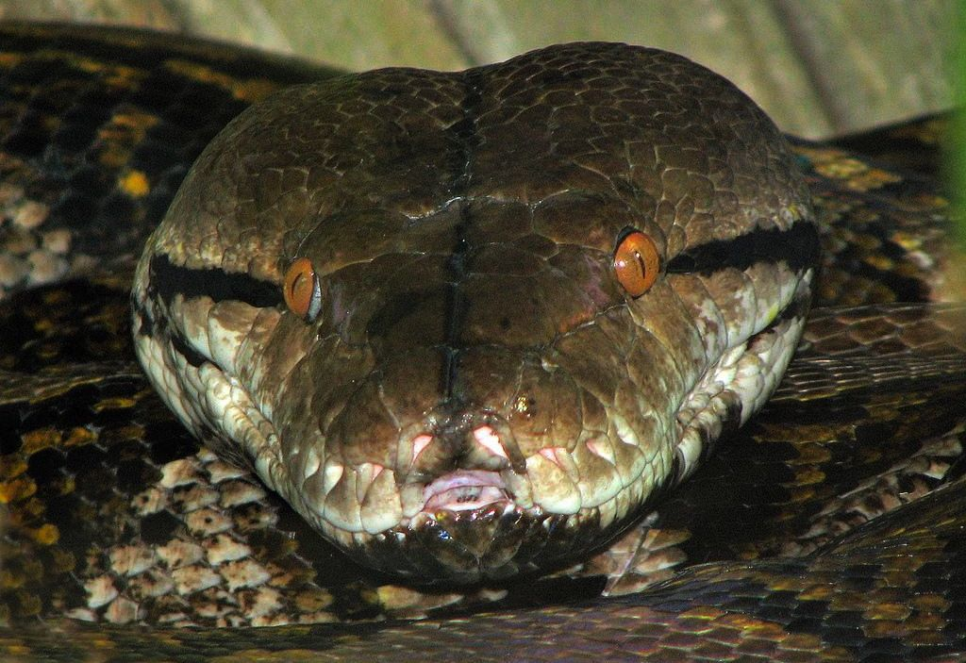
CHAPTER 13 TUPLES

Slide 2
Unit 2:
XI
Computer Science (083)
Board : CBSE
Computational Thinking and Programming
Courtesy CBSE

Slide 3
LEARNING OUTCOMES

Slide 4
LEARNING OUTCOMES
After studying this lesson, students will be able to:
Understand the need of Tuples;
Solve problems by using Tuples;
Get clear idea about Tuple functions; and
Understand the difference between list, dictionary and tuples.

Slide 5
WHAT IS TUPLE?

Slide 6
WHAT IS TUPLE?
A tuple is a sequence of values, which can be of any type and they are indexed by integer. Tuples are just like list, but we can’t change values of tuples in place. Thus tuples are immutable.
The index value of tuple starts from 0.
A tuple consists of a number of values separated by commas. For example:
>>> T=10, 20, 30, 40
>>> print (T)
(10, 20, 30, 40)

Slide 7
CREATING EMPTY TUPLE

Slide 8
CREATING EMPTY TUPLE

Slide 9
ACCESSING TUPLE

Slide 10
ACCESSING TUPLE

Slide 11
ACCESSING TUPLE USING LOOPS

Slide 12
ACCESSING TUPLE USING LOOPS

Slide 13
ACCESSING TUPLE USING LOOPS
OUTPUT

Slide 14
CHECK IF ITEM EXISTS

Slide 15
CHECK IF ITEM EXISTS
OUTPUT

Slide 16
TUPLE LENGTH

Slide 17
TUPLE LENGTH
OUTPUT

Slide 18
REMOVING A TUPLE

Slide 19
REMOVING A TUPLE
You cannot remove or delete or update items in a tuple.
Tuples are unchangeable, so you cannot remove items from it, but you can delete the tuple completely:
NOTE: TUPLES ARE IMMUTABLE

Slide 20
TUPLE METHODS

Slide 21
TUPLE METHODS
Python provides two built-in methods that you can use on tuples.
1. count() Method
2. index() Method

Slide 22
TUPLE METHODS
1. count() Method
Return the number of times the value appears in the tuple
Count() method returns total no times ‘banana’ present in the given tuple

Slide 23
TUPLE METHODS
2. index() Method
index() Method
index() Method returns index of “banana” i.e 1

Slide 24
DIFFERENCE BETWEEN
LIST AND TUPLE

Slide 25
DIFFERENCE BETWEEN LIST AND TUPLE
LIST | TUPLE
Syntax for list is slightly different comparing with tuple | Syntax for tuple is slightly different comparing with lists
Weekdays=[‘Sun’,’Mon’, ‘wed’,46,67] type(Weekdays) class<‘lists’> | twdays = (‘Sun’, ‘mon', ‘tue', 634) type(twdays) class<‘tuple’>
List uses [ and ] (square brackets) to bind the elements. | Tuple uses rounded brackets( and ) to bind the elements.

Slide 26
DIFFERENCE BETWEEN LIST AND TUPLE
LIST | TUPLE
List can be edited once it is created in python. Lists are mutable data structure. | A tuple is a list which one cannot edit once it is created in Python code. The tuple is an immutable data structure
More methods or functions are associated with lists. | Compare to lists tuples have Less methods or functions.

Slide 27
DIFFERENCE BETWEEN
TUPLE AND DICTIONARY

Slide 28
DIFFERENCE BETWEEN TUPLE AND DICTIONARY
TUPLE | DICTIONARY
Order is maintained. | Ordering is not guaranteed.
They are immutable | Values in a dictionary can be changed.
They can hold any type, and types can be mixed. | Every entry has a key and a value

Slide 29
DIFFERENCE BETWEEN TUPLE AND DICTIONARY
TUPLE | DICTIONARY
Elements are accessed via numeric (zero based) indices | Elements are accessed using key's values
There is a difference in syntax and looks easy to define tuple | Differ in syntax, looks bit complicated when compare with Tuple or lists

Slide 30
Class Test

Slide 31
PROGRAMS ON TUPLE
BELLOW AVERAGE PROGRAMS

Slide 32
TUPLE - BELLOW AVERAGE PROGRAMS
1. Write a Python program to create a tuple.
#Create an empty tuple
x = ()
print(x)
#Create an empty tuple with tuple() function
#built-in Python
tuplex = tuple()
print(tuplex)

Slide 33
TUPLE - BELLOW AVERAGE PROGRAMS
2. Write a Python program to create a tuple with
different data types
#Create a tuple with different data types
tuplex = ("tuple", False, 3.2, 1)
print(tuplex)

Slide 34
TUPLE - BELLOW AVERAGE PROGRAMS
3. Write a Python program to unpack a tuple in several variables
#create a tuple
tuplex = 4, 8, 3
print(tuplex)
n1, n2, n3 = tuplex
#unpack a tuple in variables
print(n1 + n2 + n3)
#the number of variables must be equal to the number of items of the tuple
n1, n2, n3, n4= tuplex

Slide 35
TUPLE - AVERAGE PROGRAMS

Slide 36
TUPLE - AVERAGE PROGRAMS
4 Write a Python program to find the index of an item of a tuple.
#create a tuple
tuplex = tuple("index tuple")
print(tuplex)
#get index of the first item whose value is passed as parameter
index = tuplex.index("p")
print(index)
#define the index from which you want to search
index = tuplex.index("p", 5)

Slide 37
TUPLE - AVERAGE PROGRAMS
print(index)
#define the segment of the tuple to be searched
index = tuplex.index("e", 3, 6)
print(index)
#if item not exists in the tuple return ValueError Exception
index = tuplex.index("y")

Slide 38
TUPLE - AVERAGE PROGRAMS
5. Write a Python program to add an item in a tuple.
#create a tuple
tuplex = (4, 6, 2, 8, 3, 1)
print(tuplex)
#tuples are immutable, so you can not add new elements
#using merge of tuples with the + operator you can add an element and it will create a new tuple
tuplex = tuplex + (9,)
print(tuplex)

Slide 39
TUPLE - AVERAGE PROGRAMS
5. Write a Python program to add an item in a tuple.
#adding items in a specific index
tuplex = tuplex[:5] + (15, 20, 25) + tuplex[:5]
print(tuplex)
#converting the tuple to list
listx = list(tuplex)
#use different ways to add items in list
listx.append(30)
tuplex = tuple(listx)
print(tuplex)

Slide 40
TUPLE – CLASS WORK/ HOME WORK PROGRAMS

Slide 41
TUPLE - AVERAGE PROGRAMS
6. Write a Python program to convert a tuple to a string.
7. Write a Python program to get the 4th element and 4th element from last of a tuple.
8. Write a Python program to find the repeated items of a tuple.
9. Write a Python program to check whether an element exists within a tuple.

Slide 42
Class Test
Time: 40 Min Max Marks: 20
What is tuple? give example 02
Write a python script to access a tuple 05
Explain 2 built in methods of dictionary 10
Differentiate between tuple and list 05

Slide 43
Thank You

